Slide 1
السّلام عليڪم ورحمة اللہ وبرڪاتہ

Slide 2

General equations of Straight lines
A linear equation in two variables x and y is an equation of the form
$$ax+by+c=0 ….. (i)$$
where $a, b and c$ are real numbers and $a and b$ are not both zero.

Slide 3
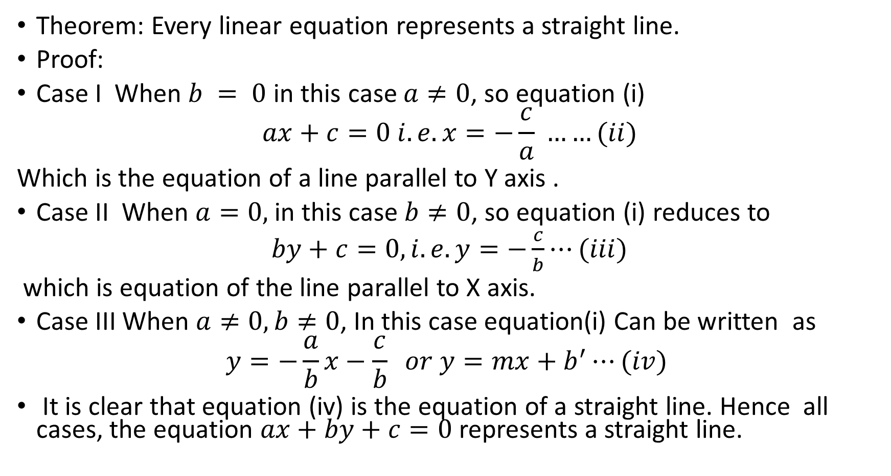
Theorem: Every linear equation represents a straight line.
Proof:
Case I When $b = 0$in this case $a≠0$, so equation (i)
$$ax+c=0 i.e. x=−\frac{c}{a} ……(ii)$$
Which is the equation of a line parallel to Y axis .
Case II When $a=0,$ in this case $b≠0$, so equation (i) reduces to
$by+c=0, i.e. y=−\frac{c}{b}⋯(iii)$
which is equation of the line parallel to X axis.
Case III When $a≠0, b≠0$, In this case equation(i) Can be written as
$$y=−\frac{a}{b}x−\frac{c}{b} or y=mx+b^{′}⋯(iv)$$
It is clear that equation (iv) is the equation of a straight line. Hence all cases, the equation $ax+by+c=0$represents a straight line.

Slide 4
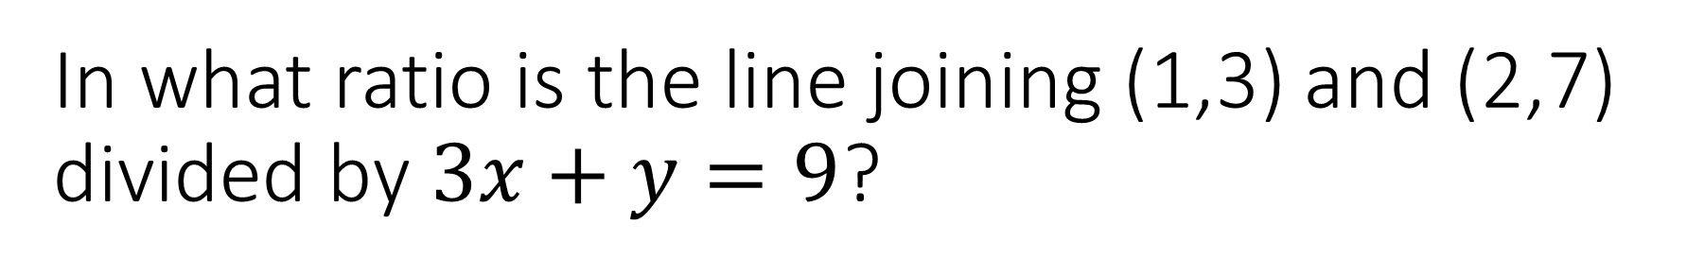
In what ratio is the line joining (1,3) and (2,7) divided by $3x+y=9$?
Let the required ratio be $1:λ$. Then the point which divides the join of (1,3) and (2,7) in the ratio $1:λ$ is $\left(\frac{2+λ\left(1\right)}{1+λ},\frac{7+λ\left(3\right)}{1+λ}\right) i.e.\left(\frac{2+λ}{1+λ},\frac{7+3λ}{1+λ}\right)$ with $1+λ≠0.$ we have used the formula$\left(\frac{x_{2}+λx_{1}}{1+λ},\frac{y_{2}+λy_{1}}{1+λ}\right).$
Let the required ratio be 1:𝜆. Then the point which divides the join of (1,3) and (2,7) in the ratio 1:𝜆 is ((2+𝜆(1))/(1+𝜆),(7+𝜆(3))/(1+𝜆)) 𝑖.𝑒.((2+𝜆)/(1+𝜆),(7+3𝜆)/(1+𝜆)) with 1+𝜆≠0. we have used the formula((𝑥_2+𝜆𝑥_1)/(1+𝜆),(𝑦_2+𝜆𝑦_1)/(1+𝜆)).

Slide 5
In what ratio is the line joining (1,3) and (2,7) divided by $3x+y=9$?
Since this point lies on the given line, so its coordinates must satisfy its equation. Thus $3\left(\frac{2+λ}{1+λ}\right)+\frac{7+3λ}{1+λ}=9$.
Since this point lies on the given line, so its coordinates must satisfy its equation. Thus 3((2+𝜆)/(1+𝜆))+(7+3𝜆)/(1+𝜆)=9.
Or $6+3λ+7+3λ=9+9λ$
Or 6+3𝜆+7+3𝜆=9+9𝜆
Or $3λ=4$
Or 3𝜆=4
Or $λ=\frac{4}{3}$. Therefore, the required ratio is $1:\frac{4}{3}$ or $3:$4
Or 𝜆=4/3 . Therefore, the required ratio is 1:4/3 or 3:4

Slide 6
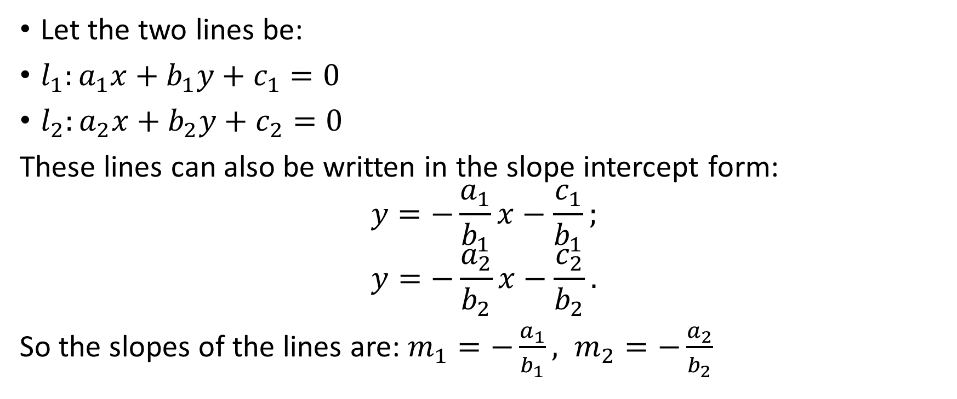
Angle between two lines from l₁ to l₂ in the general form
Let the two lines be:
$l_{1}:a_{1}x+b_{1}y+c_{1}=0$
$l_{2}:a_{2}x+b_{2}y+c_{2}=0$
These lines can also be written in the slope intercept form:
$$y=−\frac{a_{1}}{b_{1}}x−\frac{c_{1}}{b_{1}};$$
$$y=−\frac{a_{2}}{b_{2}}x−\frac{c_{2}}{b_{2}}.$$
So the slopes of the lines are: $m_{1}=−\frac{a_{1}}{b_{1}}, m_{2}=−\frac{a_{2}}{b_{2}}$

Slide 7
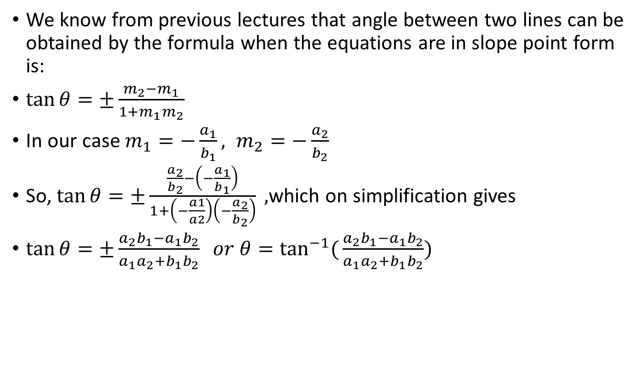
We know from previous lectures that angle between two lines can be obtained by the formula when the equations are in slope point form is:
$\tan{θ=±\frac{m_{2}−m_{1}}{1+m_{1}m_{2}} }$
In our case $m_{1}=−\frac{a_{1}}{b_{1}}, m_{2}=−\frac{a_{2}}{b_{2}}$
So, $\tan{θ=±\frac{\frac{a_{2}}{b_{2}}−\left(−\frac{a_{1}}{b_{1}}\right)}{1+\left(−\frac{a1}{a2}\right)\left(−\frac{a_{2}}{b_{2}}\right)} },$which on simplification gives
$\tan{θ=±\frac{a_{2}b_{1}−a_{1}b_{2}}{a_{1}a_{2}+b_{1}b_{2}} or θ=\tan^{−1}({\frac{a_{2}b_{1}−a_{1}b_{2}}{a_{1}a_{2}+b_{1}b_{2}}}})$

Slide 8
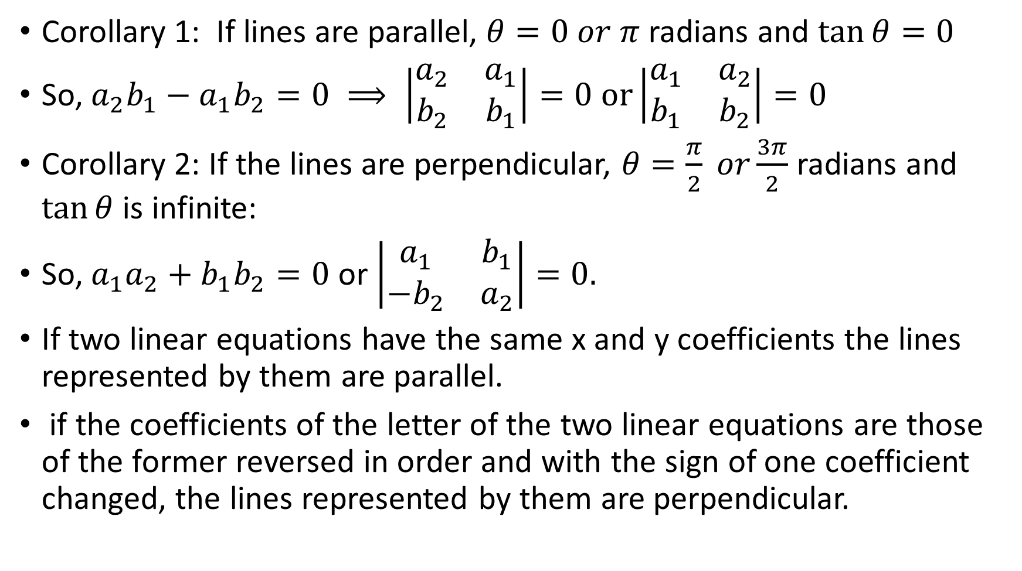
Corollary 1: If lines are parallel, $θ=0 or π$ radians and $\tan{θ}=0$
So, $a_{2}b_{1}−a_{1}b_{2}=0 ⟹ \left|\begin{matrix}a_{2} & a_{1} \\ b_{2} & b_{1}\end{matrix}\right|=0 or\left|\begin{matrix}a_{1} & a_{2} \\ b_{1} & b_{2}\end{matrix}\right|=0$
Corollary 2: If the lines are perpendicular, $θ=\frac{π}{2} or\frac{3π}{2}$ radians and $\tan{θ}$ is infinite:
So, $a_{1}a_{2}+b_{1}b_{2}=0$ or $\left|\begin{matrix}a_{1} & b_{1} \\ −b_{2} & a_{2}\end{matrix}\right|=0.$
If two linear equations have the same x and y coefficients the lines represented by them are parallel.
if the coefficients of the letter of the two linear equations are those of the former reversed in order and with the sign of one coefficient changed, the lines represented by them are perpendicular.

Slide 9
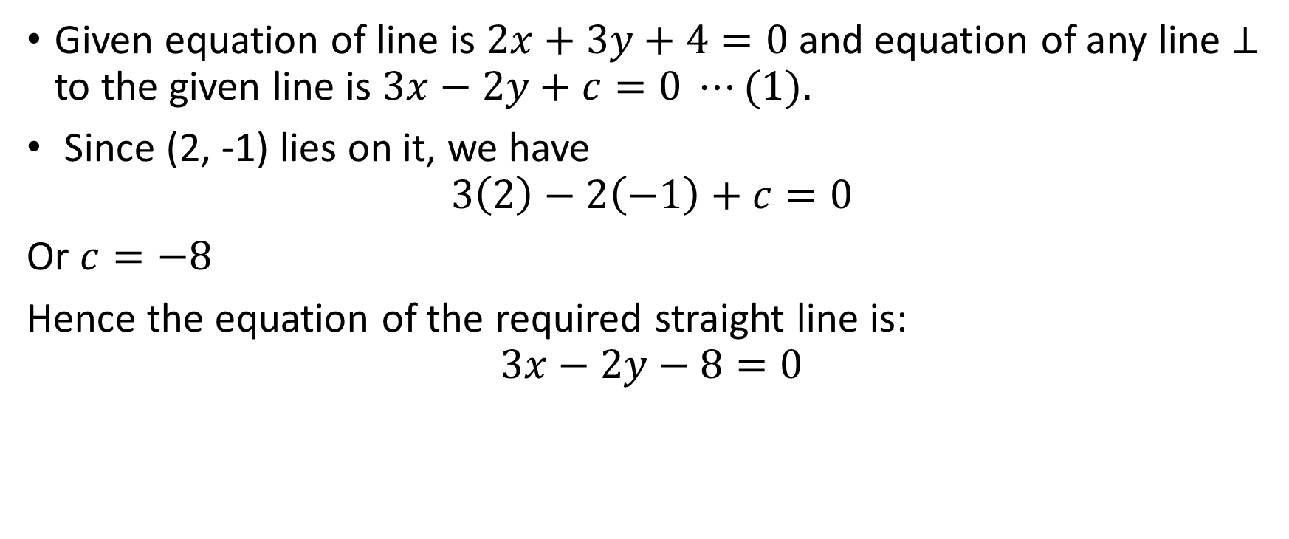
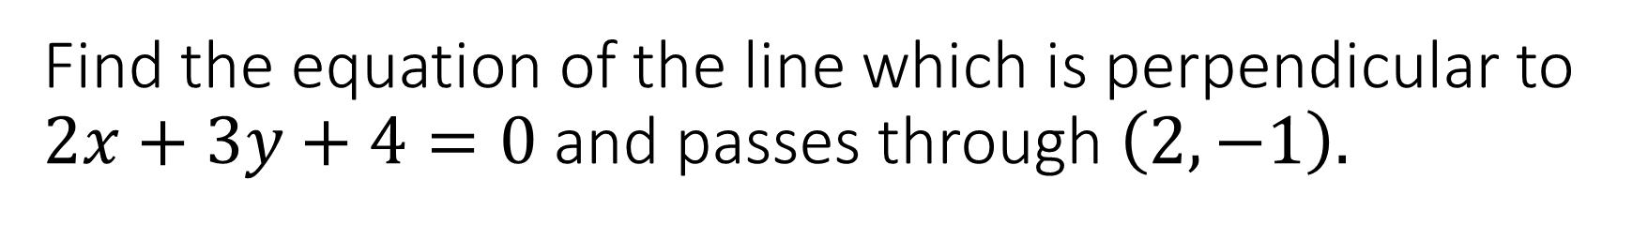
Find the equation of the line which is perpendicular to $2x+3y+4=0$ and passes through $\left(2,−1\right).$
Given equation of line is $2x+3y+4=0$ and equation of any line $⊥$ to the given line is $3x−2y+c=0 ⋯(1).$
Since (2, -1) lies on it, we have
$$3\left(2\right)−2\left(−1\right)+c=0$$
Or $c=−8$
Hence the equation of the required straight line is:
$$3x−2y−8=0$$

Slide 10
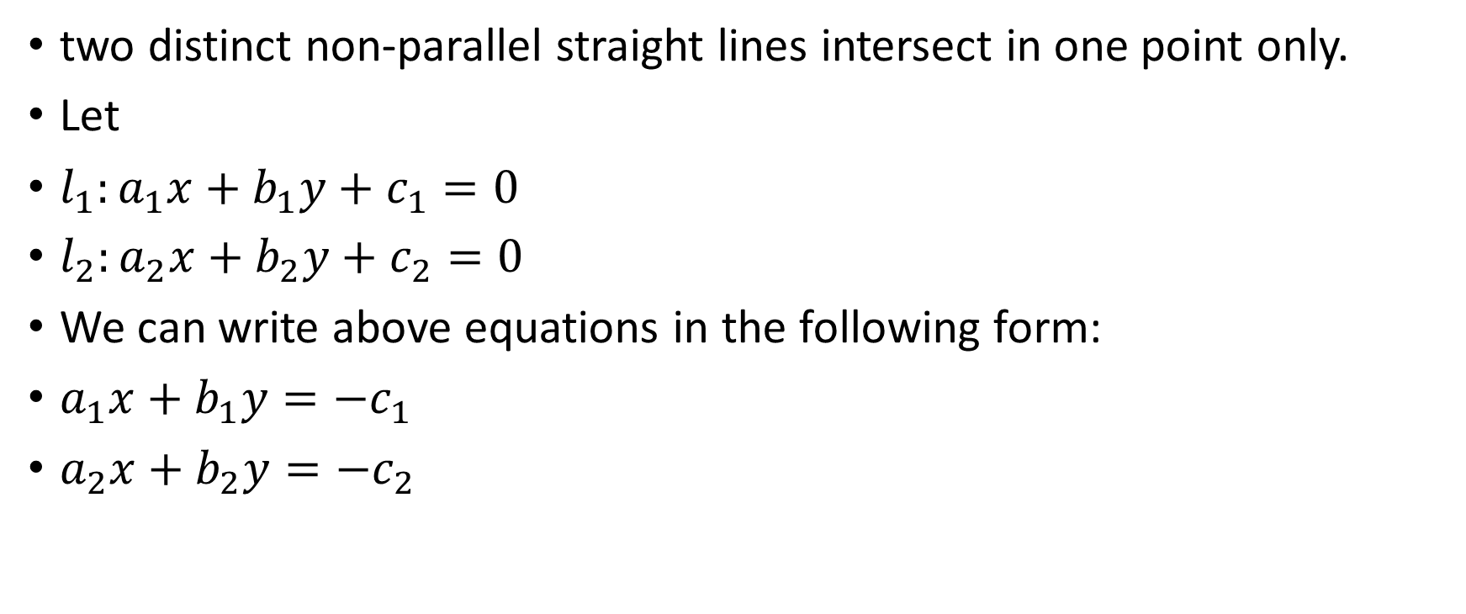
Point of intersection of two straight lines
two distinct non-parallel straight lines intersect in one point only.
Let
$l_{1}:a_{1}x+b_{1}y+c_{1}=0$
$l_{2}:a_{2}x+b_{2}y+c_{2}=0$
We can write above equations in the following form:
$a_{1}x+b_{1}y=−c_{1}$
$a_{2}x+b_{2}y=−c_{2}$

Slide 11

Since the straight lines are not parallel, $\left|\begin{matrix}a_{1} & b_{1} \\ a_{2} & b_{2}\end{matrix}\right|≠0,$
Hence by using Crammer’s Rule:
$x=\frac{\left|\begin{matrix}−c_{1} & b_{1} \\ −c_{2} & b_{2}\end{matrix}\right|}{\left|\begin{matrix}a_{1} & b_{1} \\ a_{2} & b_{2}\end{matrix}\right|}=\frac{b_{1}c_{2}−b_{2}c_{1}}{a_{1}b_{2}−a_{2}b_{1}}$ and
$y=\frac{\left|\begin{matrix}a_{1} & {−c}_{1} \\ a_{2} & {−c}_{2}\end{matrix}\right|}{\left|\begin{matrix}a_{1} & b_{1} \\ a_{2} & b_{2}\end{matrix}\right|}=\frac{c_{1}a_{2}−c_{2}a_{1}}{a_{1}b_{2}−a_{2}b_{1}}$.

Slide 12
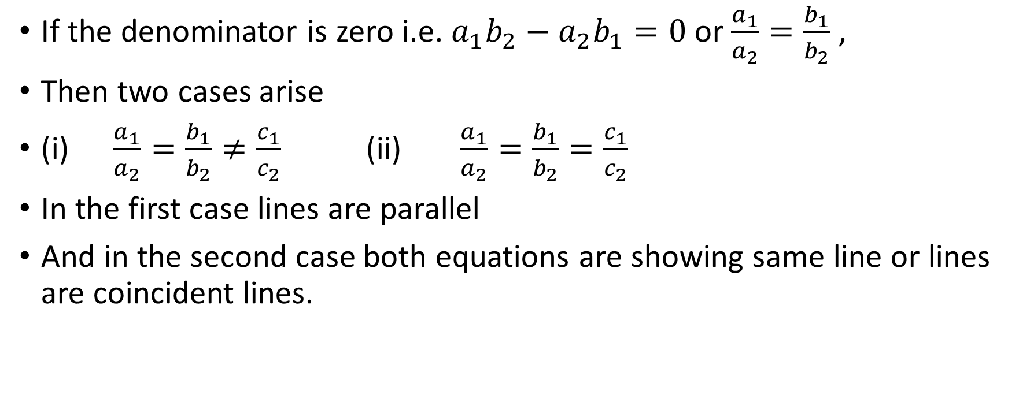
If the denominator is zero i.e. $a_{1}b_{2}−a_{2}b_{1}=0$ or $\frac{a_{1}}{a_{2}}=\frac{b_{1}}{b_{2}}$ ,
Then two cases arise
(i) $\frac{a_{1}}{a_{2}}=\frac{b_{1}}{b_{2}}≠\frac{c_{1}}{c_{2}}$ (ii) $\frac{a_{1}}{a_{2}}=\frac{b_{1}}{b_{2}}=\frac{c_{1}}{c_{2}}$
In the first case lines are parallel
And in the second case both equations are showing same line or lines are coincident lines.

Slide 13
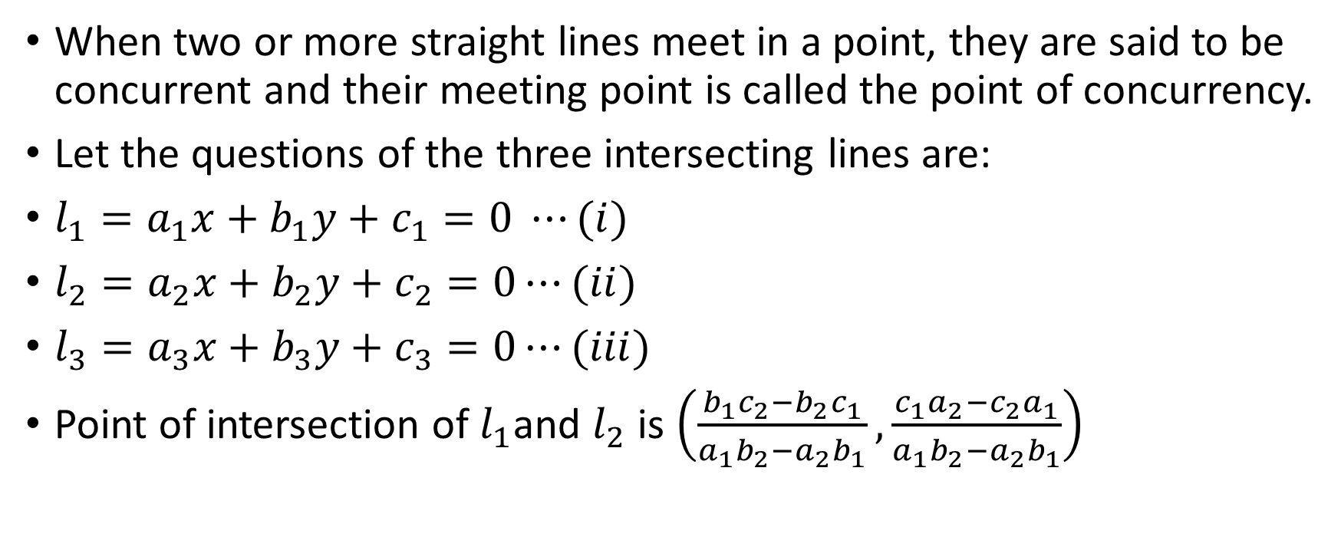
Concurrency of three lines
When two or more straight lines meet in a point, they are said to be concurrent and their meeting point is called the point of concurrency.
Let the questions of the three intersecting lines are:
$l_{1}=a_{1}x+b_{1}y+c_{1}=0 ⋯(i)$
$l_{2}=a_{2}x+b_{2}y+c_{2}=0⋯(ii)$
$l_{3}=a_{3}x+b_{3}y+c_{3}=0⋯(iii)$
Point of intersection of $l_{1}$and $l_{2}$ is $\left(\frac{b_{1}c_{2}−b_{2}c_{1}}{a_{1}b_{2}−a_{2}b_{1}}, \frac{c_{1}a_{2}−c_{2}a_{1}}{a_{1}b_{2}−a_{2}b_{1}}\right)$

Slide 14
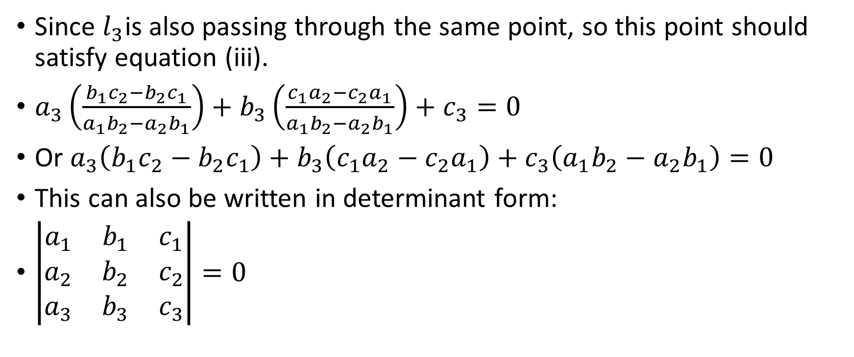
Since $l_{3}$is also passing through the same point, so this point should satisfy equation (iii).
$a_{3}\left(\frac{b_{1}c_{2}−b_{2}c_{1}}{a_{1}b_{2}−a_{2}b_{1}}\right)+b_{3}\left(\frac{c_{1}a_{2}−c_{2}a_{1}}{a_{1}b_{2}−a_{2}b_{1}}\right)+c_{3}=0$
Or $a_{3}\left(b_{1}c_{2}−b_{2}c_{1}\right)+b_{3}\left(c_{1}a_{2}−c_{2}a_{1}\right)+c_{3}\left(a_{1}b_{2}−a_{2}b_{1}\right)=0$
This can also be written in determinant form:
$\left|\begin{matrix}a_{1} & b_{1} & c_{1} \\ a_{2} & b_{2} & c_{2} \\ a_{3} & b_{3} & c_{3}\end{matrix}\right|=0$

Slide 15
This condition is not sufficient to ensure that the three given lines are concurrent, however it can be shown that if the above determinant vanishes then determinant, either the given lines are parallel or concurrent.

Slide 16
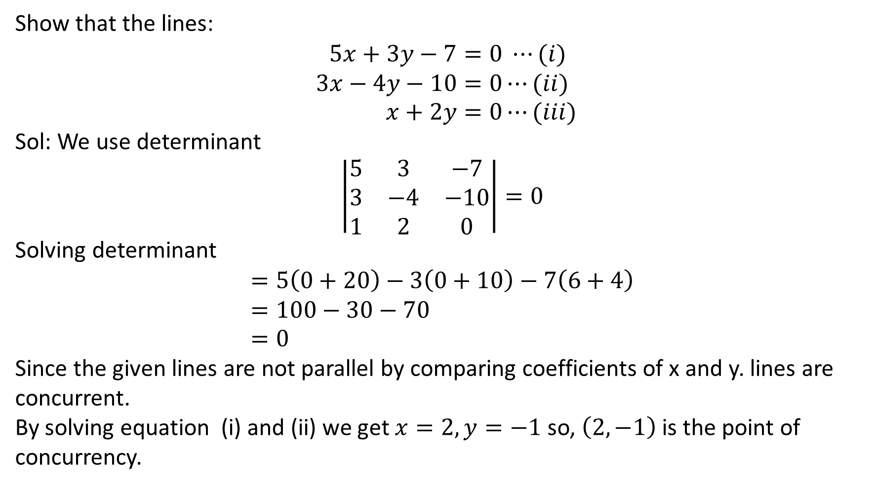
Show that the lines:
$$5x+3y−7=0 ⋯(i) \\ 3x−4y−10=0⋯(ii) \\ x+2y=0⋯(iii)$$
Sol: We use determinant
$$\left|\begin{matrix}5 & 3 & −7 \\ 3 & −4 & −10 \\ 1 & 2 & 0\end{matrix}\right|=0$$
Solving determinant
$$=5\left(0+20\right)−3\left(0+10\right)−7\left(6+4\right) \\ =100−30−70 \\ =0$$
Since the given lines are not parallel by comparing coefficients of x and y. lines are concurrent.
By solving equation (i) and (ii) we get $x=2, y=−1$ so, $\left(2,−1\right)$ is the point of concurrency.

Slide 17
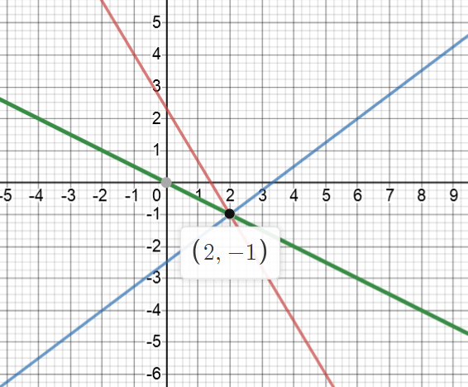
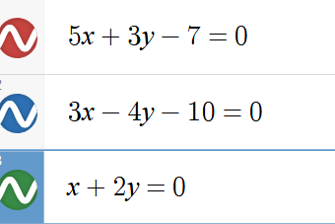
Here is the graph

Slide 18
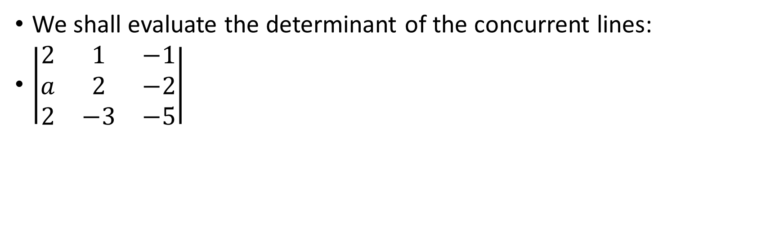
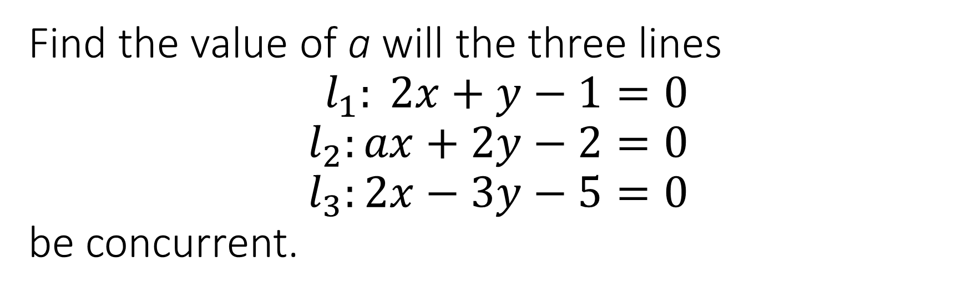
Find the value of a will the three lines $$l_{1}: 2x+y−1=0 \\ l_{2}:ax+2y−2=0 \\ l_{3}:2x−3y−5=0$$ be concurrent.
We shall evaluate the determinant of the concurrent lines:
$\left|\begin{matrix}2 & 1 & −1 \\ a & 2 & −2 \\ 2 & −3 & −5\end{matrix}\right|$

Slide 19
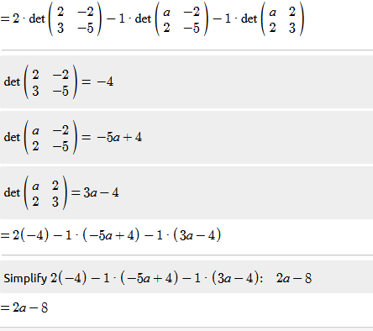

Value of the determinant is $2a−8$ which should be equal to 0, so
$$2a−8=0 \\ a=4 Ans:$$

Slide 20






Proof that the altitudes of any triangle are concurrent
$$Y$$
C$(0,c)$
$$X$$
O$(0,0)$
$$A(a,0)$$
B$(b,0)$

Slide 21
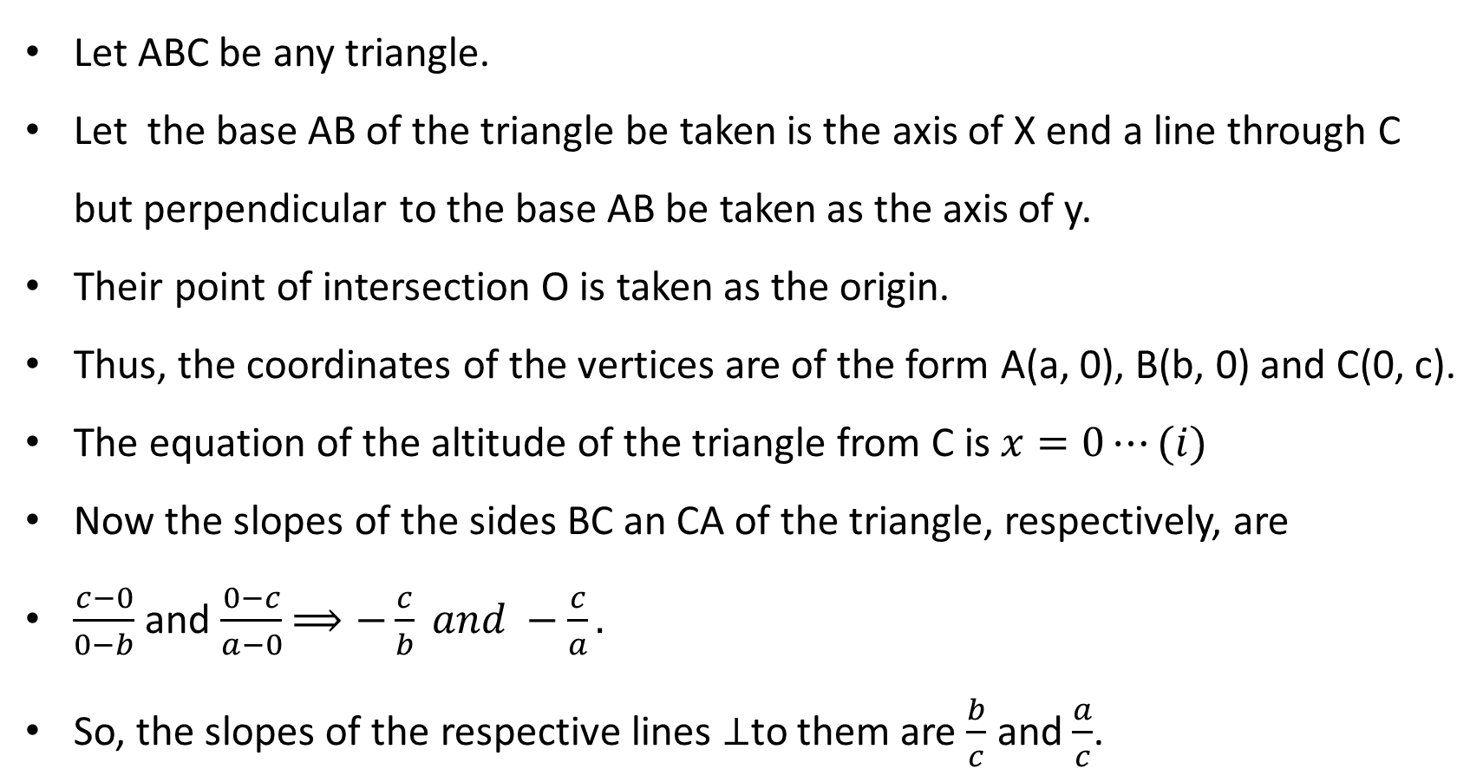
Let ABC be any triangle.
Let the base AB of the triangle be taken is the axis of X end a line through C but perpendicular to the base AB be taken as the axis of y.
Their point of intersection O is taken as the origin.
Thus, the coordinates of the vertices are of the form A(a, 0), B(b, 0) and C(0, c).
The equation of the altitude of the triangle from C is $x=0⋯(i)$
Now the slopes of the sides BC an CA of the triangle, respectively, are
$\frac{c−0}{0−b}$ and $\frac{0−c}{a−0}$ $⟹−\frac{c}{b} and −\frac{c}{a}.$
So, the slopes of the respective lines $⊥$to them are $\frac{b}{c}$ and $\frac{a}{c}$.

Slide 22
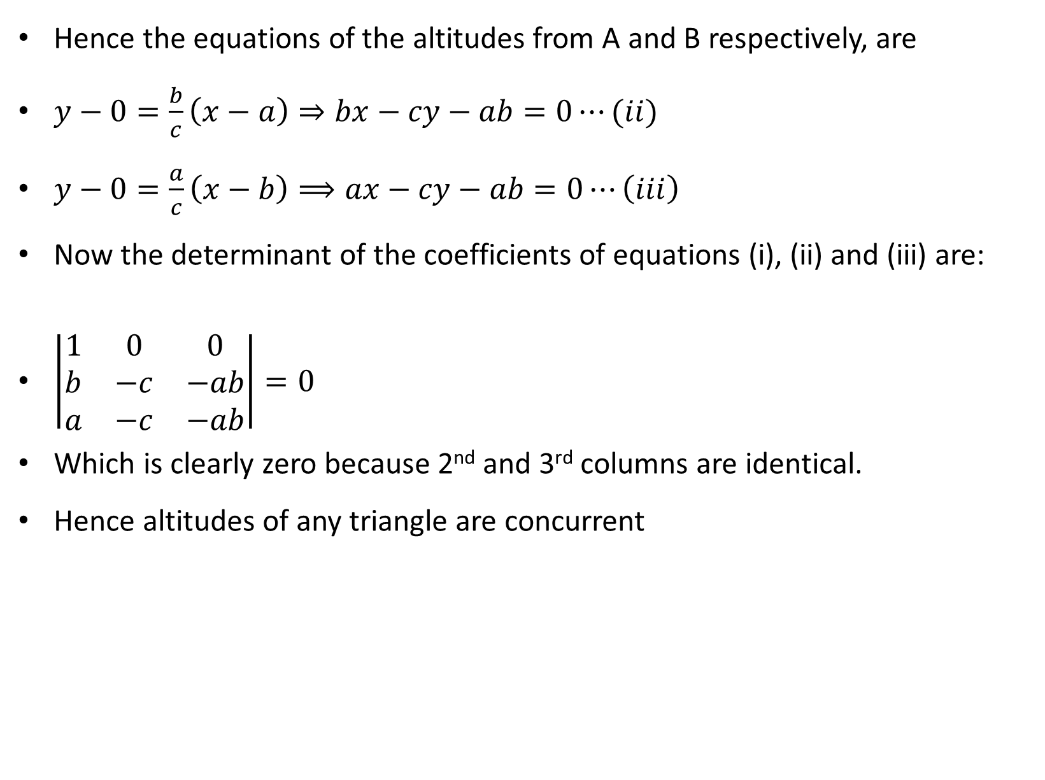
Hence the equations of the altitudes from A and B respectively, are
$y−0=\frac{b}{c}\left(x−a\right)⇒bx−cy−ab=0⋯(ii)$
$y−0=\frac{a}{c}\left(x−b\right)⟹ax−cy−ab=0⋯\left(iii\right)$
Now the determinant of the coefficients of equations (i), (ii) and (iii) are:
$\left|\begin{matrix}1 & 0 & 0 \\ b & −c & −ab \\ a & −c & −ab\end{matrix}\right|=0$
Which is clearly zero because 2nd and 3rd columns are identical.
Hence altitudes of any triangle are concurrent

Slide 23
EXERCISE PROBLEMS

Slide 24
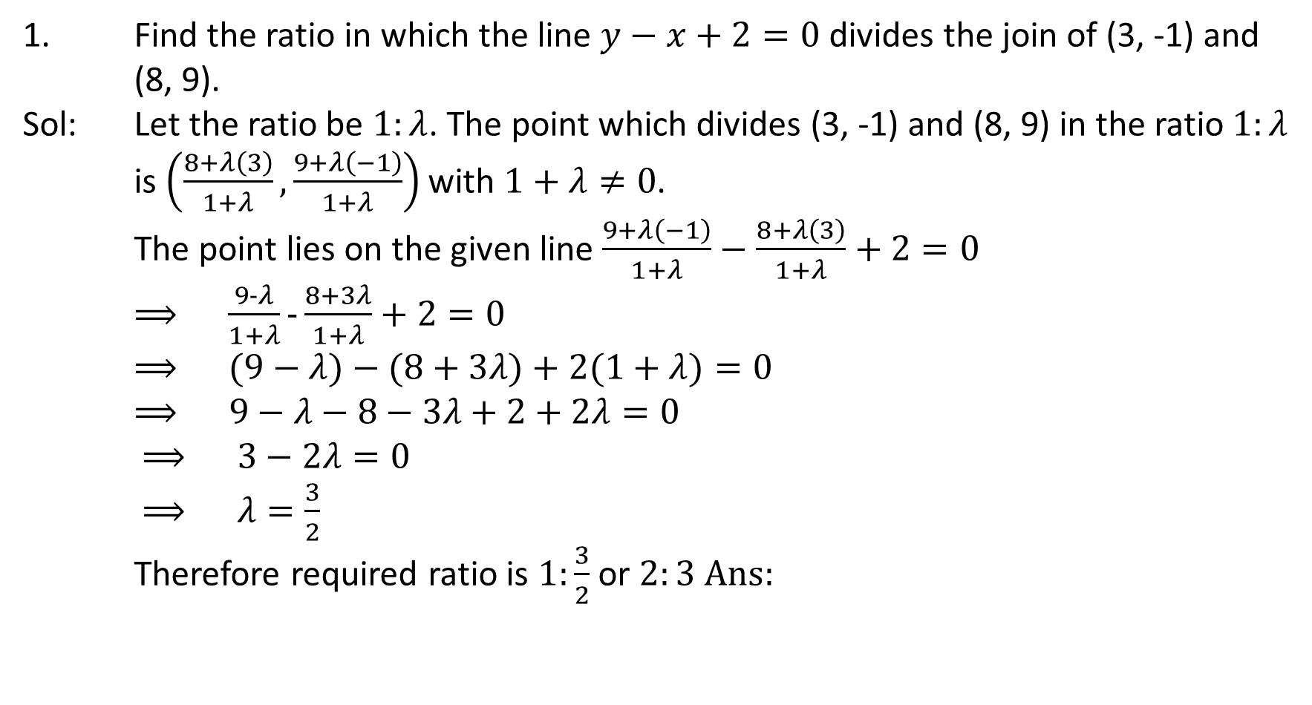
1. Find the ratio in which the line $y−x+2=0$ divides the join of (3, -1) and (8, 9).
Sol: Let the ratio be $1:λ$. The point which divides (3, -1) and (8, 9) in the ratio $1:λ$ is $\left(\frac{8+λ\left(3\right)}{1+λ},\frac{9+λ\left(−1\right)}{1+λ}\right)$ with $1+λ≠0$.
The point lies on the given line $\frac{9+λ\left(−1\right)}{1+λ}−$ $\frac{8+λ\left(3\right)}{1+λ}+2=0$
$⟹ \frac{9−λ}{1+λ}−\frac{8+3λ}{1+λ}+2=0$ $⟹ (9−λ)−(8+3λ)+2(1+λ)=0$ $⟹ 9−λ−8−3λ+2+2λ=0$ $⟹ 3−2λ=0$
$⟹ λ=\frac{3}{2}$
Therefore required ratio is $1:\frac{3}{2}$ or $2:3 Ans:$

Slide 25

Reduce the equation $x−2y−3=0$ to the slope intercept form two intercepts form .
Sol:
Slope intercept form:
$x−3=2y$
$y=\frac{1}{2}x −\frac{3}{2}, ⟹ slope m=\frac{1}{2} and y−intercept c=−\frac{3}{2}$
Two intercept form:
$x−3=2y$
$x−2y=3$
$\frac{x}{3}+\frac{y}{−\frac{3}{2}}=1 ⟹x−intercept=3 and y−intercept=−\frac{3}{2}$

Slide 26
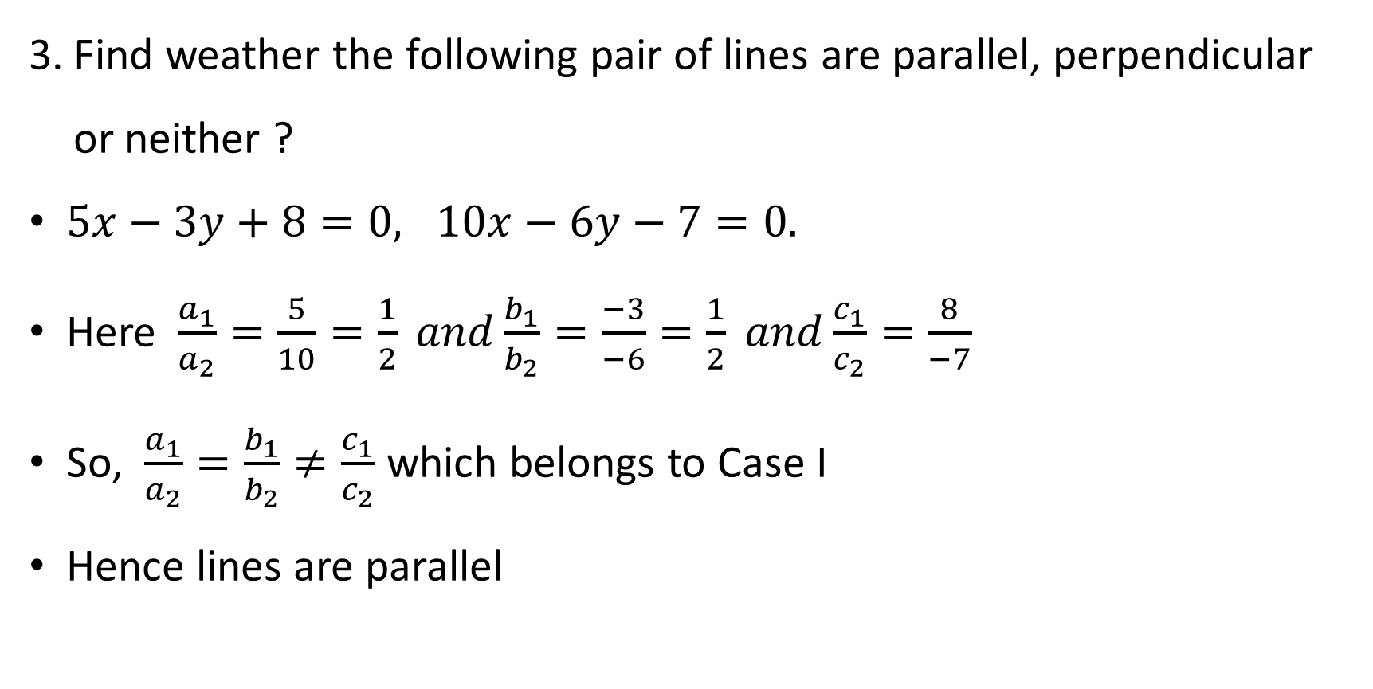
Find weather the following pair of lines are parallel, perpendicular or neither ?
$5x−3y+8=0, 10x−6y−7=0.$
Here $\frac{a_{1}}{a_{2}}=\frac{5}{10}=\frac{1}{2} and\frac{b_{1}}{b_{2}}=\frac{−3}{−6}=\frac{1}{2} and\frac{c_{1}}{c_{2}}=\frac{8}{−7}$
So, $\frac{a_{1}}{a_{2}}=\frac{b_{1}}{b_{2}}≠\frac{c_{1}}{c_{2}}$ which belongs to Case I
Hence lines are parallel

Slide 27
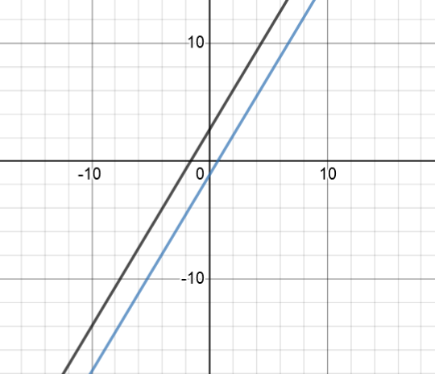
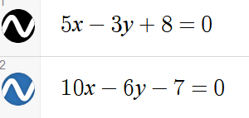

Slide 28
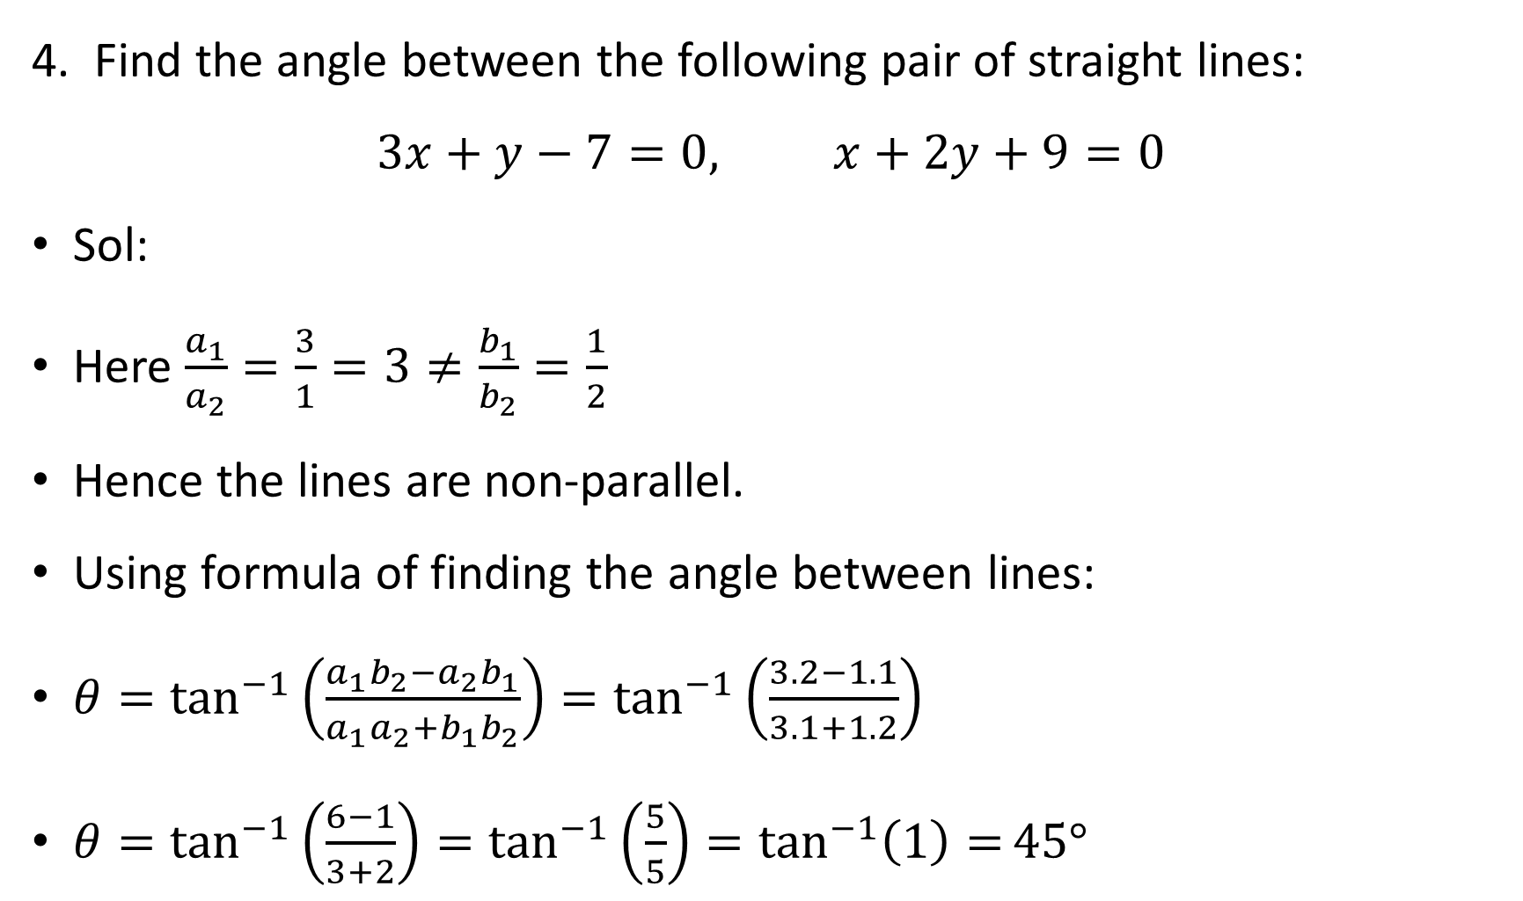
4. Find the angle between the following pair of straight lines:
$$3x+y−7=0, x+2y+9=0$$
Sol:
Here $\frac{a_{1}}{a_{2}}=\frac{3}{1}=3≠\frac{b_{1}}{b_{2}}=\frac{1}{2}$
Hence the lines are non-parallel.
Using formula of finding the angle between lines:
$θ=\tan^{−1}\left(\frac{{a_{1}b_{2}−a}_{2}b_{1}}{a_{1}a_{2}+b_{1}b_{2}}\right)=\tan^{−1}\left(\frac{3.2−1.1}{3.1+1.2}\right)$
$θ=\tan^{−1}\left(\frac{6−1}{3+2}\right)=\tan^{−1}\left(\frac{5}{5}\right)=\tan^{−1}\left(1\right)=45°$

Slide 29
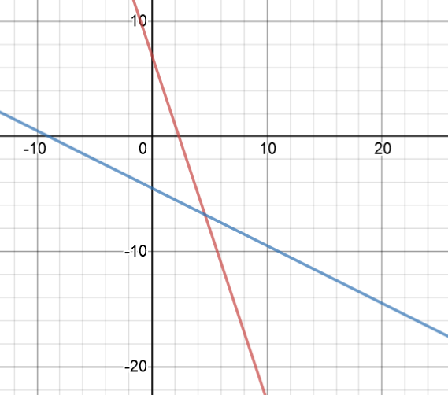
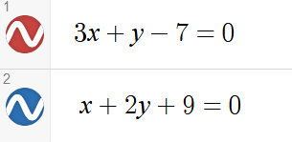


$$45°$$
$$45°$$

